Slide 1
Chapter 9 Internet Control Message Protocol Version 4 (ICMPv4)

Slide 2
Outline
Introduction
Message
Debugging Tools
ICMP Package

Slide 3
Introduction
IP provides unreliable and connectionless datagram delivery
Drawbacks
Lack of error control mechanism
Lack of assistance mechanism
Solution
ICMP

Slide 4
Lack of Error Control Mechanism
No error-reporting or error-correcting mechanism
What happens if a router must discard a datagram because
Cannot find a router to the destination
Time-to-live field has a zero value
What happens if the final destination host must discard all received fragments of a datagram
Because it has not received all fragments within a predefined time limit

Slide 5
Lack of Assistance Mechanism
Lack of a mechanism for host and router for management queries
How to determine if a router or another host is alive?
How to obtain information from another host or router?

Slide 6
Solution
ICMP: Internet Control Message Protocol
A network layer protocol
However, its message are not passed directly to the data link layer
The message are first encapsulated inside IP datagram before going to the lower layer

Slide 7
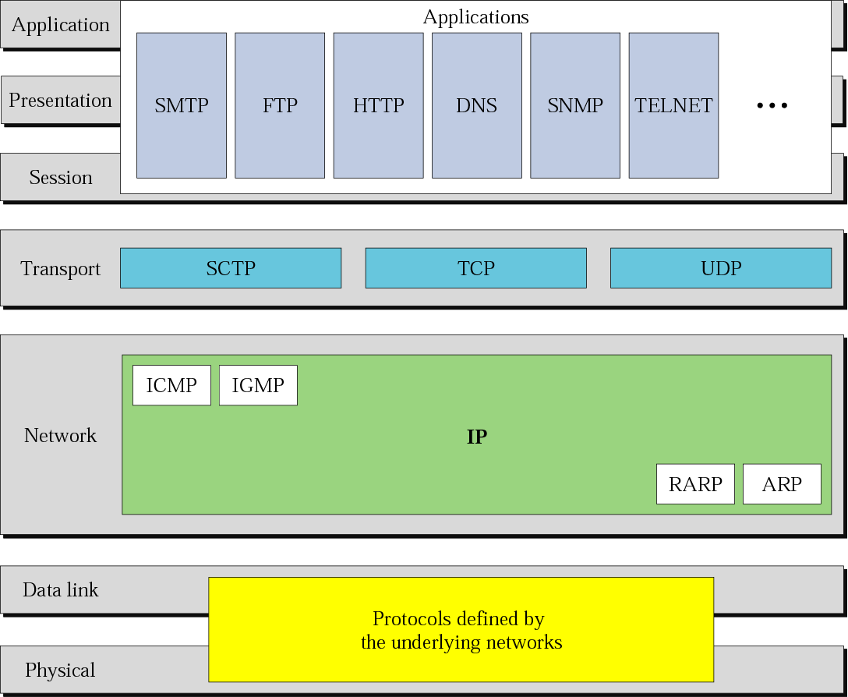
Position of ICMP in TCP/IP Protocol Suite
The McGraw-Hill Companies, Inc., 2000

Slide 8
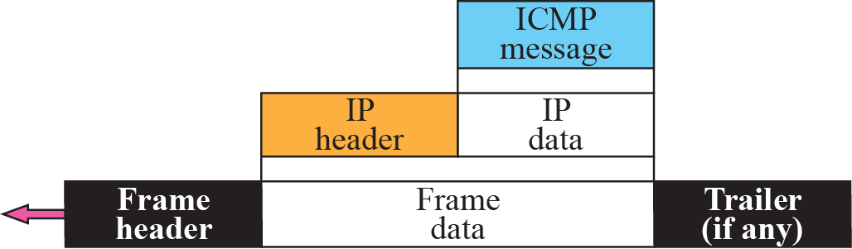
Figure 9-2
Encapsulation of ICMP Packet
The McGraw-Hill Companies, Inc., 2000

Slide 9
Outline
Introduction
Message
Debugging Tools
ICMP Package

Slide 10
ICMP Messages
ICMP messages are divided into
Error-reporting message
Report problems that a router or a host (destination) may encounter when it processes an IP packet
Query message
Help a router or a network manager to get specific information from a router or another host

Slide 11
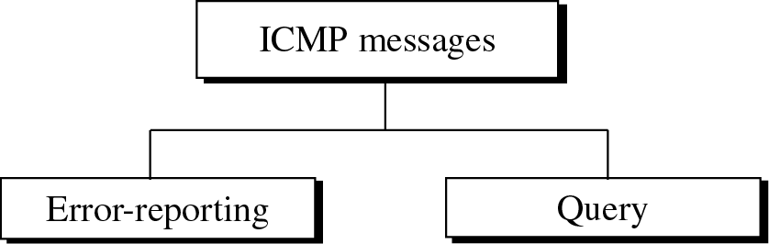
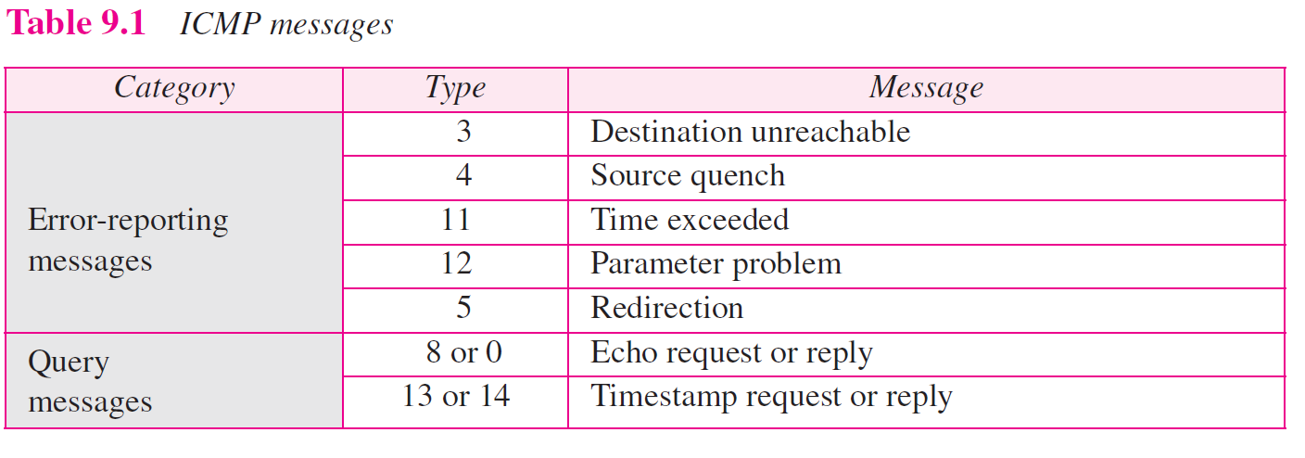
ICMP Messages

Slide 12
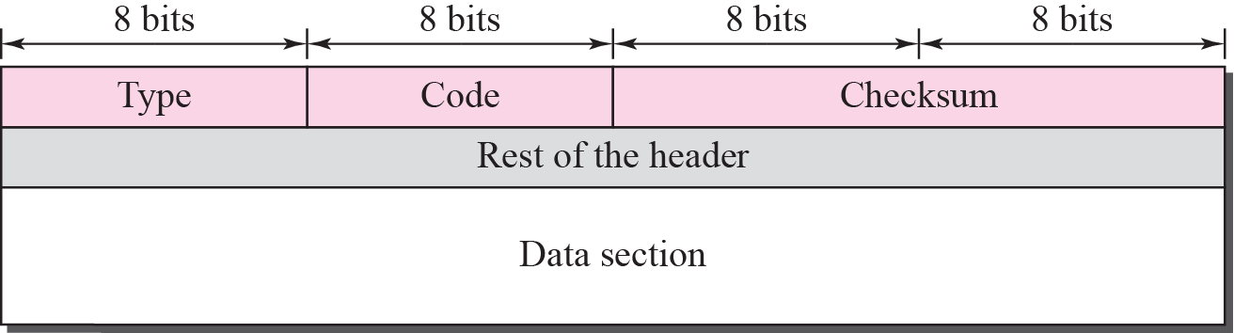
Figure 9-4
General Format of ICMP Messages
The McGraw-Hill Companies, Inc., 2000

Slide 13
Message Format
8-byte header
The first 4-byte are common to all
Type(1-byte): define the type of the message
Code(1-byte): specify the reason for the particular message type
Checksum(2-byte)
The rest is specific for each message type
A variable-size data section
For error-reporting message
Carries information for finding the original packet that had the error
For query message
Carries extra information based on the type of the query

Slide 14
Error Reporting Messages
ICMP only report error
Does not correct error
Error correction is left to the higher-level protocol
Error reporting message are always sent to the original source

Slide 15
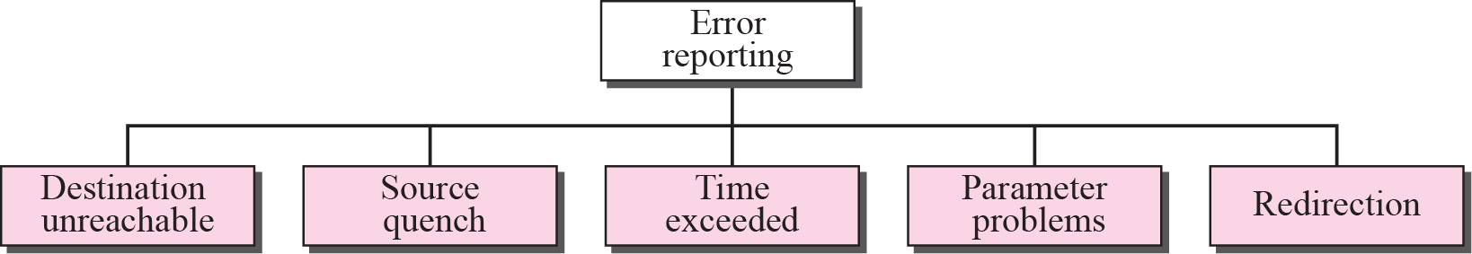
Figure 9-5
Error-Reporting Messages
The McGraw-Hill Companies, Inc., 2000

Slide 16
Important Points about ICMP Error Messages
No ICMP error message for a datagram carrying an ICMP error message
Prevent the problem of infinite loop
No ICMP error message for a fragmented datagram that is not the first fragment
No ICMP error message for a datagram having a multicast address.
No ICMP error message for a datagram with a special address such as 127.0.0.0 or 0.0.0.0.

Slide 17
ICMP Packet Data Section
The data section in all error message contain includes
The IP header of the original datagram
Give the original source information about the datagram itself
The first 8-byte of data in that datagram
Provides information about the port number (UDP and TCP) and sequence number (TCP)
Source then can inform the upper layer protocols (TCP or UDP) about the error

Slide 18
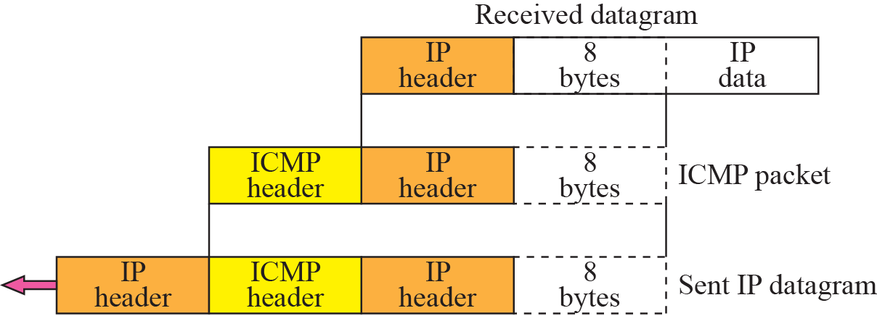
Figure 9-6
Contents of Data Field for Error Messages
The McGraw-Hill Companies, Inc., 2000

Slide 19
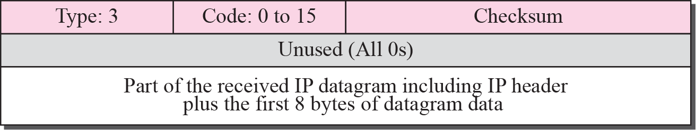
Destination Unreachable
When a router cannot route a datagram or a host cannot deliver a datagram
Discard the datagram
The router or host sends a destination unreachable message back to the source host

Slide 20
Code Field for Destination-Unreachable
Code 0: the network is unreachable
Possibly due to hardware failure
Can only be generated by a router
Code 1: the host is unreachable
Possibly due to hardware failure
Can only be generated by a router
Code 2: the protocol is unreachable
Delivery to the upper layer protocol (TCP, UDP) is failed
Can only be generated by a destination host

Slide 21
Code Field for Destination-Unreachable (Cont.)
Code 3: the port is unreachable
Can only be generated by the destination host
Code 4: fragmentation is required, but the DF (do not fragment) field has been set
The sender specifies no fragmentation
But the router is impossible without fragmentation
Code 5: source routing cannot be accomplished
One or more routers defined in the source routing cannot be visisted

Slide 22
Code Field for Destination-Unreachable (Cont.)
Code 6: the destination network is unknown
In code 0: the router knows that the destination network exists, but it is unreachable at the moment
In code 6: the router has no information about the destination network
Code 7: the destination host is unknown
In code 1: the router knows that the destination host exists, but it is unreachable at the moment
In code 7: the router is unaware of the existence of the destination host

Slide 23
Code Field for Destination-Unreachable (Cont.)
Code 8: the source host is isolated
Code 9: communication with the destination network is administratively prohibited
Code 10: communication with the destination host is administratively prohibited
Code 11: the network is unreachable for the specified type of service
Code 12: the host is unreachable for the specified type of service

Slide 24
Code Field for Destination-Unreachable (Cont.)
Code 13: the host is unreachable because the administrator has put a filter on it
Code 14: the host is unreachable because the host precedence is violated
The requested precedence is not permitted for the destination
Code 15: the host is unreachable because its precedence was cut off

Slide 25

Note
Destination-unreachable messages with codes 2 or 3 can be created only by the
destination host. Other destination-unreachable messages can be created only by routers.

Slide 26
Error Reporting
Even if a router does not report a destination-unreachable message
Does not mean that the datagram has been delivered
For example, in a Ethernet network, there is no way that a router knows a packet has been delivered to the destination or the next router
Ethernet does not provide an acknowledge mechanism

Slide 27
Note
A router cannot detect all problems that prevent the delivery of a packet.

Slide 28
Source Quench
In IP, there is no communication between the source host, the router, and the destination
Thus, no flow control and congestion control in IP
The source never knows if it is producing datagram faster than can be
Forwarded by router
Processed by the destination host
Problem
Packet losses in routers or the destination host

Slide 29
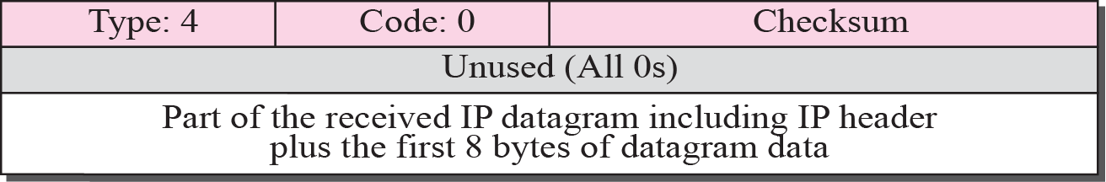
Source Quench (Cont.)
Source-quench message thus adds a kind of flow control and congestion control to the IP
Inform the source that the datagram has been discarded
Warm the source that
There is congestion somewhere in the path
The source should slow down (quench) the sending process

Slide 30
Note
A source-quench message informs the source that a datagram has been discarded due to congestion in
a router or the destination host.
The source must slow down the sending of datagrams until the congestion is relieved.

Slide 31
Note about the Source Quench
One source-quench message should be sent for each datagram that is discarded due to congestion
There is no mechanism to tell the source that the congestion has been relieved and the source can speed up its sending rate
The source continue to slower the rate until no more source-quench message are received

Slide 32
Note about the Source Quench (Cont.)
The congestion can be created either by one-to-one or many-to-one communication
In one-to-one: source quench is helpful
In many-to-one: may be useless
Each source sends datagram at a different rate
The router or the destination has no clue which source is responsible for the congestion
Thus, it may drop a datagram from a very slow source

Slide 33
Note
One source-quench message is sent for each datagram that is discarded due to congestion.

Slide 34
Figure 9-5
Error-Reporting Messages
The McGraw-Hill Companies, Inc., 2000

Slide 35
Time Exceeded: Two Situations
The packet travel in a loop or a cycle
Caused by errors in the routing table
Finally, time-to-live value is 0
The router discards the datagram and sends time-exceeded message
When all fragment that make up a message do not arrive at the destination within a certain time limit
When the first datagram arrives at the destination, it starts a timer
When the timer expires and all the fragments are not arrived
The destination discards all the fragments and sends a time-exceeded message

Slide 36
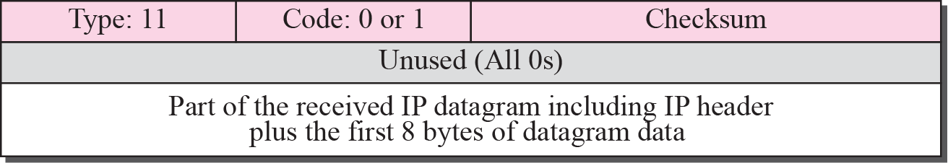
Figure 9-9
Time-Exceeded Message Format
Code 0: Time to live is zero
Code 1: Fragmentations are not arrived with a set time
The McGraw-Hill Companies, Inc., 2000

Slide 37
Parameter Problem
Occurred when a router or a destination discovers an ambiguous or missing value in any field of the datagram
Code 0: there is an error or ambiguity in one of the header fields
Pointer field points to the byte within the problem
Code 1: the required part of an option is missing

Slide 38
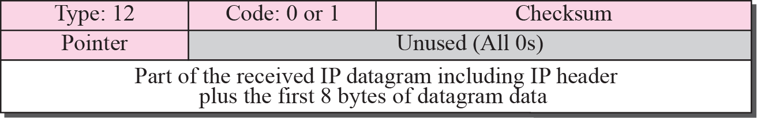
Figure 9-10
Parameter-Problem Message Format
Code 0: Main header problem Code 1: Problem in the option field
The McGraw-Hill Companies, Inc., 2000

Slide 39
Note
A parameter-problem message can be created by a router or the destination host.

Slide 40
Redirection
Routing table is updated dynamically
However, for efficiency, hosts do not take part in the routing update process
There are terrible number of hosts
Host thus use static routing
Usually knows only one IP address of the router, the default router
Thus, the host may send a datagram to the wrong router

Slide 41
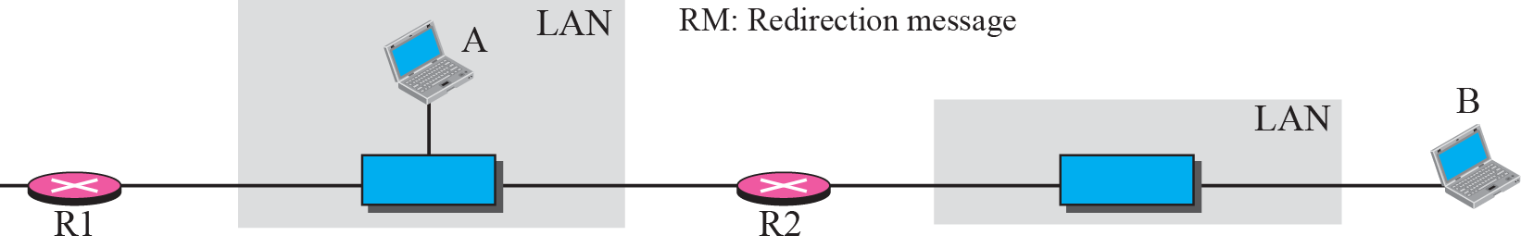
Figure 9-11
Redirection Concept
The McGraw-Hill Companies, Inc., 2000

Slide 42
Note
A host usually starts with a small routing table that is gradually augmented and updated.
One of the tools to accomplish this is the redirection message.

Slide 43
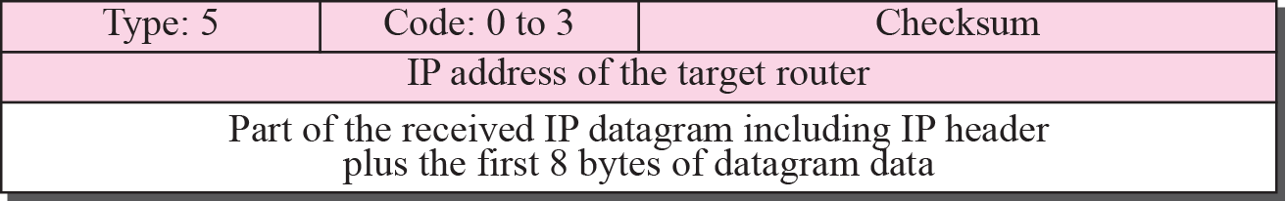
Figure 9-12
Redirection Message Format
Code 0: Redirection for a network-specific route Code 1: Redirection for a host-specific route Code 2: Redirection for a network-specific route based on a specified type of service
Code 3: Redirection for a host-specific route based on a specified type of service
The McGraw-Hill Companies, Inc., 2000

Slide 44
Note
A redirection message is sent from a router to a host on the same local network.

Slide 45
Query Messages
ICMP can also diagnose some network problems
Accomplished by the query message
A group of five different pair of messages
Three of these pairs are deprecated today
Only two pairs are used today
Echo request and reply
Timestamp request and reply

Slide 46
ICMP Messages

Slide 47
Echo Request and Reply
Determine whether two systems (hosts or routers) can communicate with each other
Determine if there is communication at the IP level
Because ICMP are encapsulated in IP datagrams
Also be used by a host to see if another host is reachable
At the user level, this is done by ping command

Slide 48
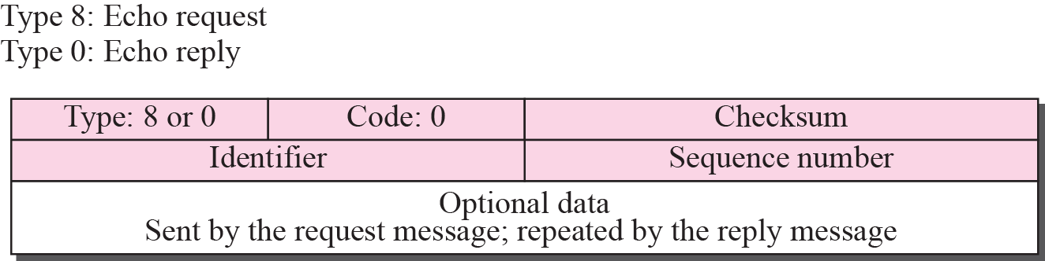
Figure 9-14
Echo-Request and Echo-Reply
Message Format
Identifier and sequence number
Are not formally defined by the protocol
Can be used arbitrarily by the sender
The McGraw-Hill Companies, Inc., 2000

Slide 49
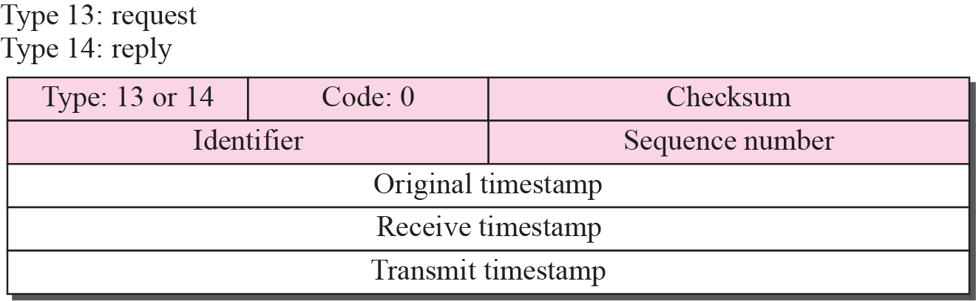
Timestamp Request and Reply
Two goals
Determine the round-trip time needed for an IP datagram
Synchronize the clocks in two machines

Slide 50
Timestamp
Original timestamp
Filled by the sender at departure time
Appear in both request and reply messages
Receive timestamp
Filled by the receiver at receiving time
Appear only at the reply message and fill zero in request message
Transmit timestamp
Filled by the receiver when the reply message departs
Appear only at the reply message and fill zero in request message

Slide 51
One-Way and Round-Trip Time
Sending time = value of receive timestamp -
value of original timestamp
Receiving time = time the packet returned -
value of transmit timestamp
Round-trip time = sending time +
receiving time

Slide 52
One-Way and Round-Trip Time (Cont.)
Note that
Sending time and receiving time are accurate only if the clocks in the source and destination are synchronized
The round-trip time is correct even if the two clocks are not synchronized
See the following next slides

Slide 53
Example
Given
Value of original timestamp: 46
Value of receive timestamp: 59
Value of transmit timestamp: 60
Time the packet arrived: 67
Derive
Sending time = 59 - 46 = 13 milliseconds
Receiving time = 67 - 60 = 7 milliseconds
Round-trip time = 13 + 7 = 20 milliseconds

Slide 54
Example (Cont.)
To show that the round-trip time is independent of time difference
Following above example, assume that the time difference is 3
Receiving node’s clock = 3 + sending node’s clock
Sending time = (56+3) – 46 = 10 + 3
Receiving time = 67 – (57+3) = 10 – 3
RRT = (10 + 3) + (10-3) = 20

Slide 55
Synchronization
Timestamp request and timestamp reply messages can also by used to synchronize the clocks in two machines

Slide 56
Example (Cont.)
Time difference = receive timestamp -
(original timestamp field + one-way time duration)
Assume the one-way time duration can be obtained by dividing the round-trip time duration by two
Note that, this assumption may be wrong, depends on the network condition
Thus, time difference = 59 - (46 + 10) = 3

Slide 57
Deprecated Messages
Three pairs of messages are declared obsolete by IETF
Information request and reply messages
Their duties are done by ARP
Address mask request and reply message
Their duties are done by DHCP (Dynamic Host Configuration Protocol)
Router solicitation and advertisement message
Their duties are done by DHCP

Slide 58
Checksum
In ICMP, the checksum is calculated over the entire message
Checksum calculation
The checksum field is set to zero
The sum of all the 16-bit words (header and data) is calculated
The sum is complemented to get the checksum
The checksum is stored in the checksum field

Slide 59
Checksum (Cont.)
Checksum testing
The sum of all words (header and data) is calculated
The sum is complemented
If the result is 16 0s, the message is accepted
Otherwise, it is rejected

Slide 60
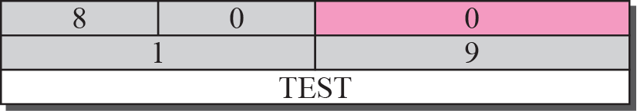
Example 9.1: Checksum Calculation
The McGraw-Hill Companies, Inc., 2000

Slide 61
Outline
Introduction
Message
Debugging Tools
ICMP Package

Slide 62
Ping
To find if a host is alive and responding
Operations
Source sends ICMP echo request message (type: 8, code:0)
Start the sequence number from 0 and increments each time a new message is sent
Destination responds with ICMP echo reply message
Can calculate the round trip time
Insert the sending time in the data section
When the packet arrives, subtract the arrival time from the departure time to get the RTT

Slide 63
Example 9.2

Slide 64
Example 9.2 (Cont.)
From above example
Sequence number starts from 0
TTL (Time to live) = 62
At the beginning
Data bytes is 56 bytes
Total number of bytes is 84 (= 56 + 8 + 20)
8 = ICMP header, 20 = IP header
The total number of bytes in the ICMP packet is 64 (= 56+8)

Slide 65
Traceroute
Trace the route of a packet from the source to the destination
TRACERT in windows
An application program that uses the services of UDP
Elegantly use two ICMP message
Time exceeded
Destination unreachable

Slide 66
Traceroute Operation
In the following figure
the traceroute program uses the following steps to find the address of R1 and RTT between host A and R1
Traceroute at host A sends a UDP packet to B and set IP’s TTL field = 1
R1 receives the packet and decrements the value of TTL to 0.
Discard the packet and sends a time-exceeded ICMP message since the TTL value is 0
The traceroute at host A receives the ICMP message and find the source address of the IP packet = IP address of R1
Repeat the a~c steps three times to get a better average RTT value
Since the first RTT would by much longer since ARP operation
Traceroute program repeats the previous steps with TTL = 2 to find the address of R2 and RTT between host A and R2

Slide 67
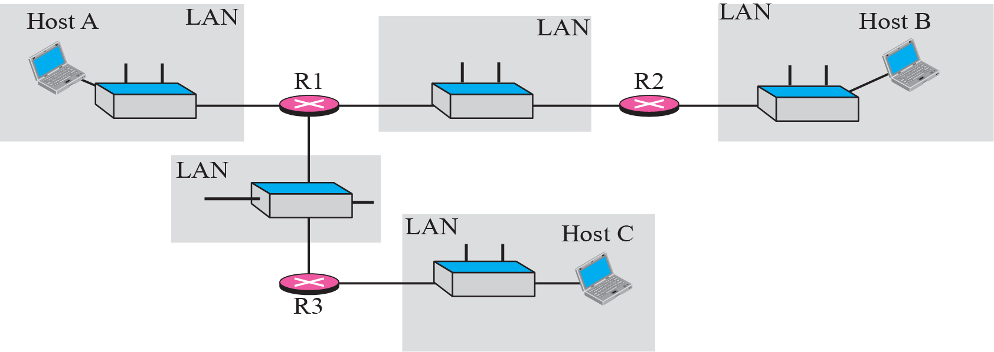
The Traceroute Program Operation

Slide 68
Traceroute Operation (Cont.)
Repeats the previous steps to find the address of host B and the RTT between host A and B
When host B receives the UDP packet
Decrement TTL to 0
Receive the packet since it is the destination (do not discard)
How can an ICMP message be sent back to host A?
The destination port of UDP packet is sent to one that is not supported by the UDP protocol
Host B cannot delivery the packet to an application
Thus, host B discard the UDP packet and sends an ICMP destination-unreachable message to host A
Once host A receiving a destination-unreachable message with code value 3
The whole route has been found

Slide 69
Example 9.4
The un-numbered line shows that
The destination is 153.18.8.1.
The TTL value is 30 hops.
The packet contains 38 bytes: 20 bytes of IP header, 8 bytes of UDP header, and 10 bytes of application data.
The application data is used by traceroute to keep track of the packets
The first line shows the first router visited.
The router is named Dcore.fhda.edu with IP address 153.18.31.254.
The first round trip time was 0.995 milliseconds, the second was 0.899 milliseconds, and the third was 0.878 milliseconds
$ traceroute fhda.edu traceroute to fhda.edu (153.18.8.1), 30 hops max, 38 byte packets 1 Dcore.fhda.edu (153.18.31.254) 0.995 ms 0.899 ms 0.878 ms 2 Dbackup.fhda.edu (153.18.251.4) 1.039 ms 1.064 ms 1.083 ms 3 tiptoe.fhda.edu (153.18.8.1) 1.797 ms 1.642 ms 1.757 ms

Slide 70
Example 9.6
An interesting point is that a host can send a traceroute packet to itself.
This can be done by specifying the host as the destination.
The packet goes to the loopback address as we expect
$ traceroute voyager.deanza.edu traceroute to voyager.deanza.edu (127.0.0.1), 30 hops max, 38 byte packets 1 voyager (127.0.0.1) 0.178 ms 0.086 ms 0.055 ms

Slide 71
Outline
Introduction
Message
Debugging Tools
ICMP Package (Skip!)

Slide 72
範圍：CHAPTER 6~9 日期：12/9
第二次考試

